Slide 1

SUBJECT : EMBEDDED SYSTEMS
UNIT – V
EMBEDDED SYSTEM DEVELOPMENT
The integrated development environment, Types of files generated on cross-compilation, Deassembler/Decompiler, Simulators, Emulators and Debugging, Target hardware debugging, Boundary Scan, Embedded Software development process and tools.

Slide 2
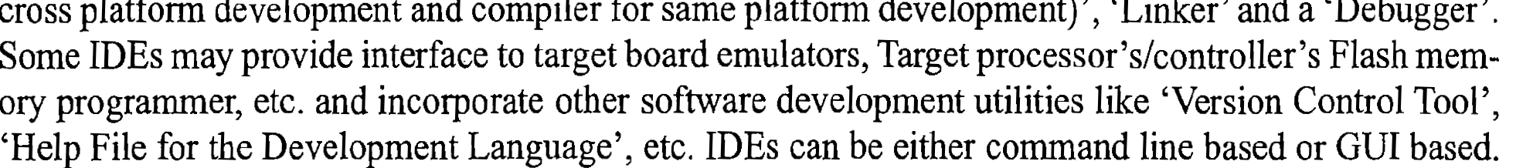
The Integrated Development Environment

Slide 3
The Keil µVision3 IDE for 8051
File Creation
Debugging with Keil µVision3 IDE
Simulating Peripherals and Interrupts with Keil µVision3 IDE
Target Level Firmware Debugging with Keil µVision3 IDE
Writing ISR in Embedded C using the Keil µVision3 IDE
Assembly based Firmware Development with Keil µVision3 IDE
Flash memory Programming with Keil µVision3 IDE

Slide 4
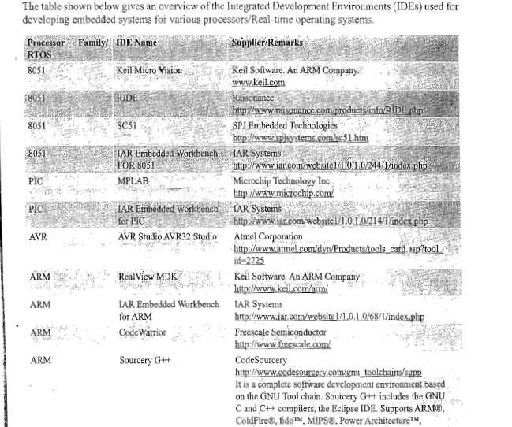

Slide 5
Types Of Files Generated On Cross-compilation
List File contains following sections:
1.Page header
2.CommandLine
3.Source code
4.Assembly listing
5.Symbol listing
6.Module information
7.Warnings and errors

Slide 6
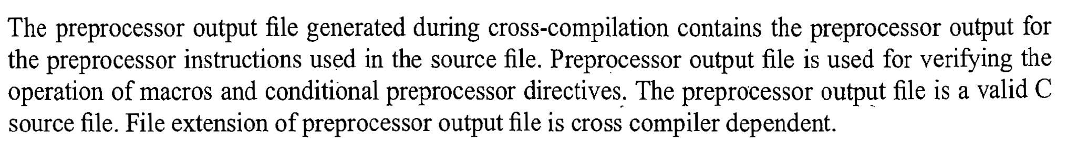
Types Of Files Generated On Cross-compilation-Preprocessing Output File

Slide 7
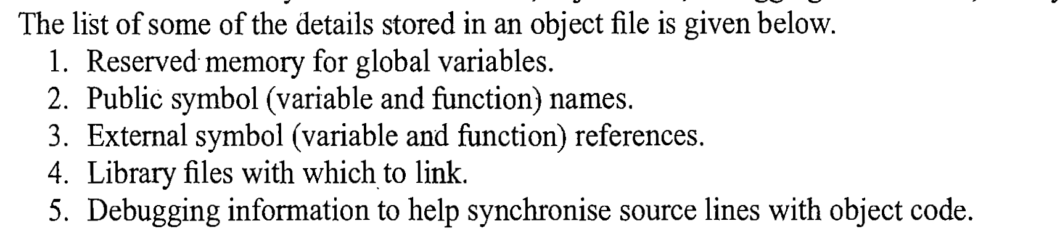
Types Of Files Generated On Cross-compilation-Object File(.OBJ File)

Slide 8
Types Of Files Generated On Cross-compilation-Map File(.MAP)
Map file contains
1.Page Header
2.Command Line
3.CPU Details
4.Input Module
5.MemoryMap
6.Symbol Table
7.Inter Module Cross Reference
8.Program size
9.Warnings and Errors

Slide 9
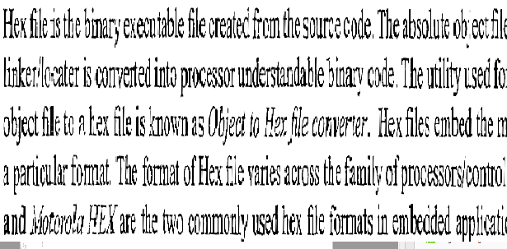
Types Of Files Generated On Cross-compilation-HEX File(.HEX)

Slide 10
Disassembler/Decompiler
Disassembler is a utility program which converts machine codes into target processor specific Assembly code.
Decompiler is a utility program which converts machine codes into corresponding high level languages.
Disassembler/Decompilers are depolyed in reverse engineering

Slide 11
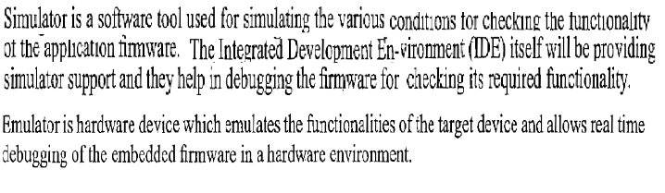
Simulators, Emulators and Debugging

Slide 12
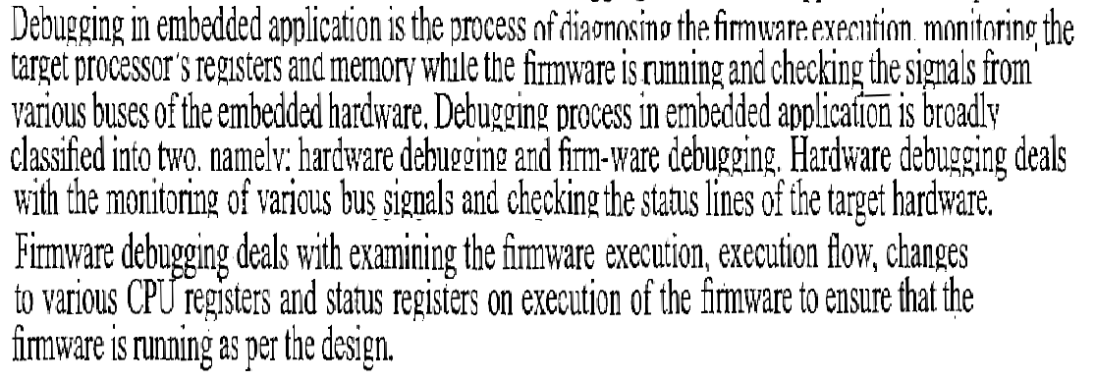
Debugging

Slide 13
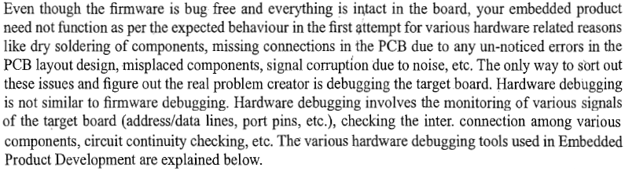
Target Hardware Debugging

Slide 14
Target Hardware Debugging
Hardware Debugging tools used in Embedded Product development are
1.Magnifying Glass(Lens)
2.Multimeter
3.Digital CRO
4.Logic Analyzer
5.Function Generator

Slide 15
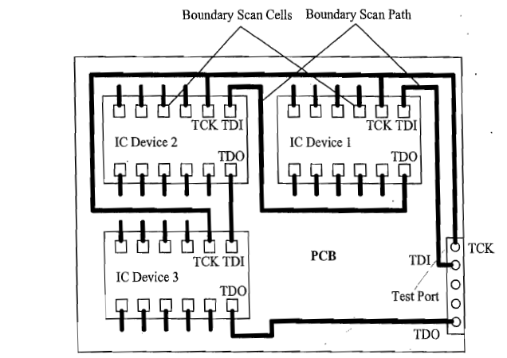
Boundary Scan

Slide 16
Assignment
Embedded Software development process and tools.

